Slide 1
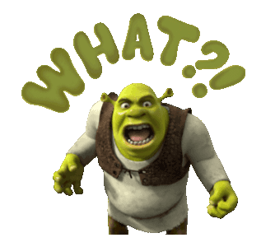
What does he look like?
1. He has a bald head.
2. He has big brown eyes.
3. He has a big round nose
and a giant mouth.
4. He has long, piped ears.
5. He is a main character in
an animated (動畫的)
movie.

Slide 2
What does she look like?

Slide 3
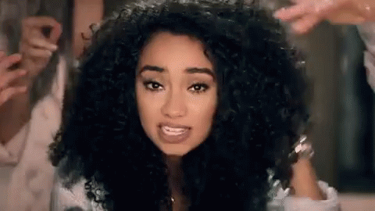
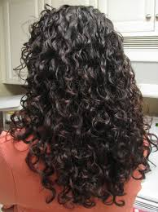
She has curly hair.

Slide 4
She has long, curly, black hair.

Slide 5
What does he look like?

Slide 6
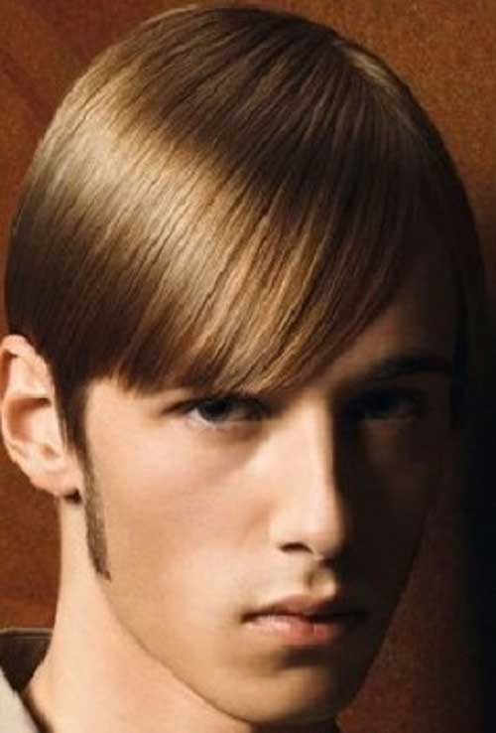
He has short hair.

Slide 7
He has short, straight, brown hair.

Slide 8
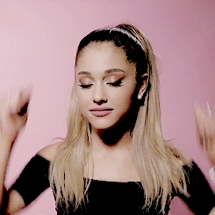
What does she look like?
She has a ponytail.
She has a long, straight, blond ponytail.

Slide 9
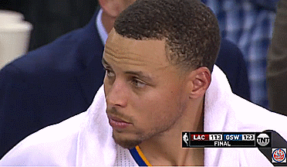
What does he look like?
He has
a black crew cut.

Slide 10
I
You
They
He
She
have
has

Slide 11
助動詞Auxiliary Verb
Do you/ they
Do /Does/ Did都有照妖鏡的功能，會把後面接的 動詞打回原形
現在式
Does he /she
Did you/ they / he/ she
過去式

Slide 12
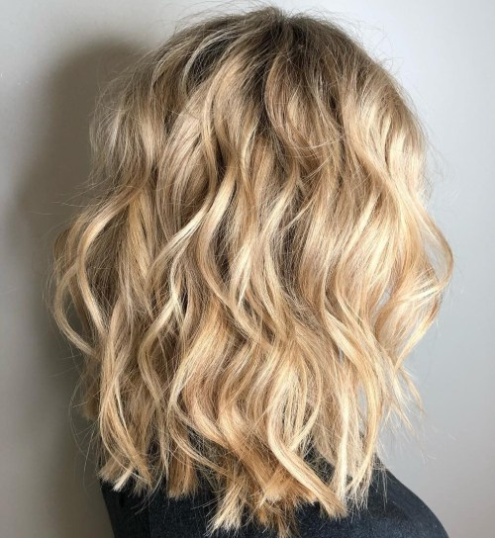
Do you have wavy hair?
Yes, I do.
I have wavy hair.

Slide 13
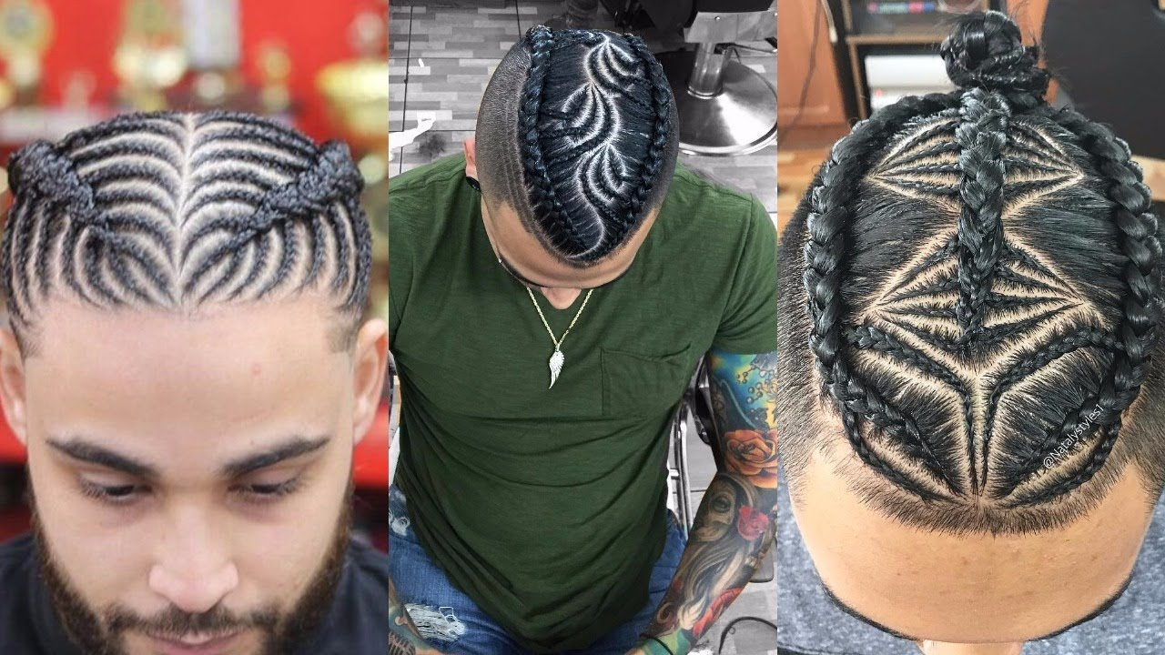
Do they have ponytails?
No, they don’t.
They have braids.

Slide 14
Does she have a crew cut?
Yes, she does.
She has a crew cut.

Slide 15
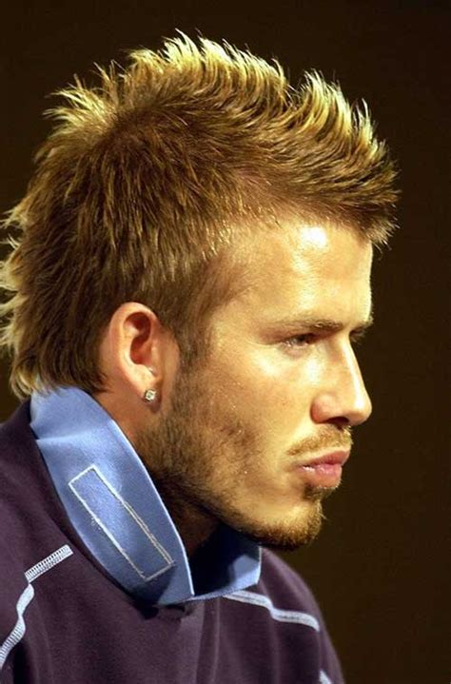
Does he have straight hair?
No, he doesn’t.
He has spiky hair.

Slide 16
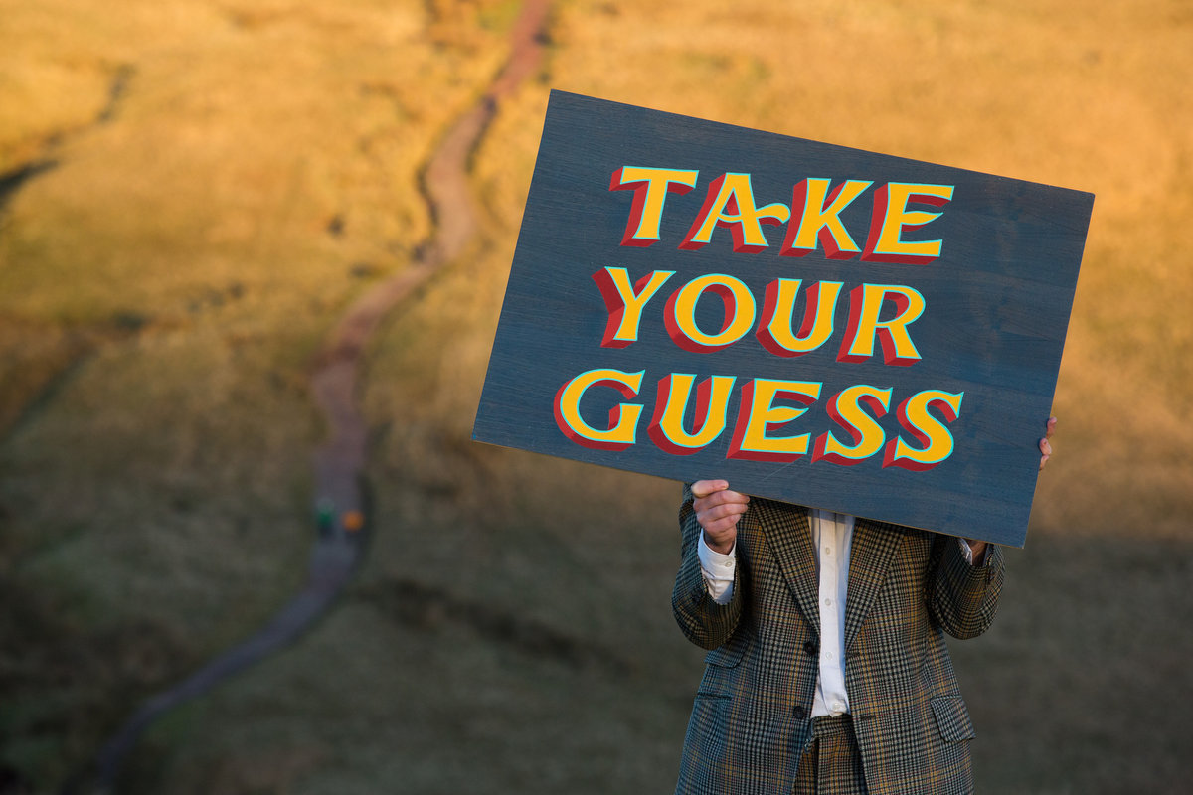

Slide 17
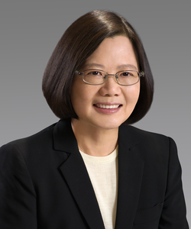
What does she look like?
She has short, straight,
black hair.
2. She has small black eyes.
3. She has a round nose and
a big mouth.
4. She is a famous leader.

Slide 18
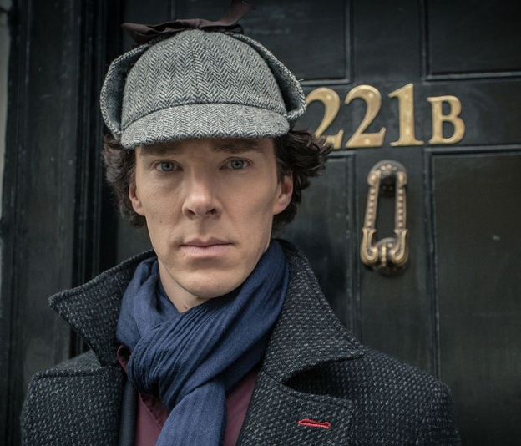
What does he look like?
He has short, curly,
brown hair.
2. He has big green eyes.
3. He has a hawk nose and
a sexy big mouth.
4. He has big ears.
5. He’s a detective and
always wears a cap.

Slide 19
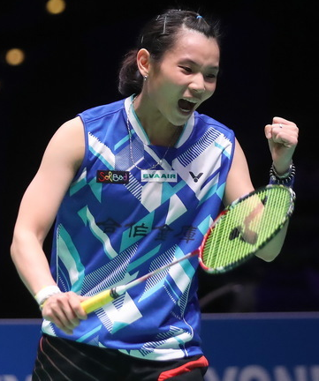
What does she look like?
She has a short, straight,
black ponytail.
2. She has small black eyes.
3. She has a round nose and
a big mouth.
4. She is good at badminton.

Slide 20
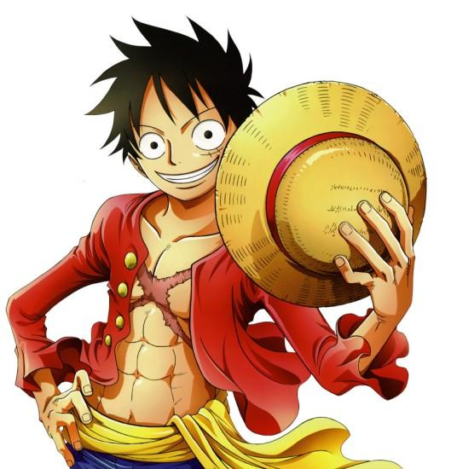
What does he look like?
He has short, spiky,
black hair.
2. He has round, big, black eyes.
3. He has a small nose and
a big mouth.
4. He’s a cartoon character and
always wears a hat. Also he’s a
pirate.

Slide 21
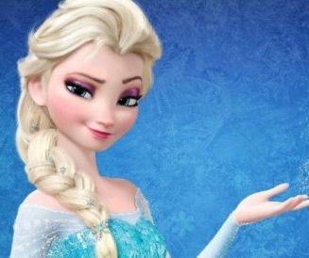
What does she look like?
She has a long, blond braid.
2. She has big green eyes.
3. She has a small nose and
a beautiful mouth.
4. She loves winter and
singing.

Slide 22
What does he look like?
He has short, straight,
black hair.
2. He has big black eyes.
3. He has a big, round nose
and a glamour mouth.
4. He has big ears.
5. He’s a teacher and
master in baseball and
swimming.

Slide 23
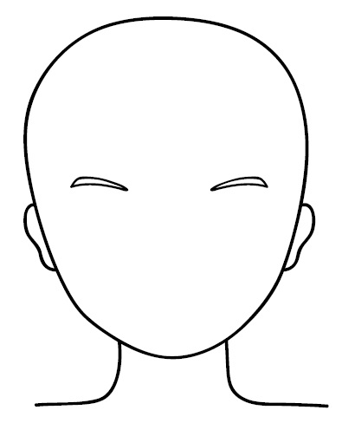
Create a face
Hair style/ color
Color of eyes
Shape of nose
Size of mouth
Size of ears.

Slide 24
【本週英語作業】
聽:CD Unit 1全。
寫:英語習作P26~P27，下週一交。
※玩Quizlet句型、文法篇

Slide 27
